Slide 1

Handicap Assistant – TTS & STT
Siri Smitha Joginapally – BG98738
Sai Kowshik Mayur Kaluvayi - IG25413
Guided by: Dr. Tony Diana

Slide 2
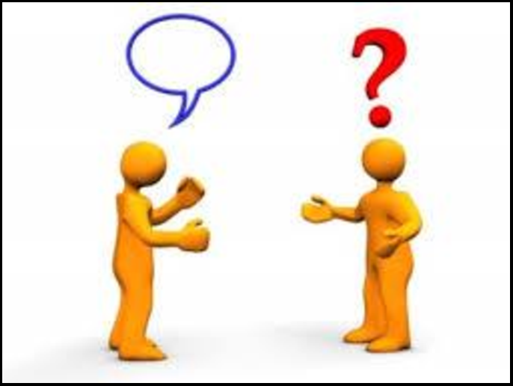

Introduction
Communication can be a very challenging task for people suffering from a hearing problem and a dumb person. This can cause loneliness and depression.
We can use advanced technologies like transformers to build a model that will help them communicate easily and be more social.
This Handicap Assistant can help reduce the communication gap.

Slide 3
Methodology
IMPORTING CNN/DAILYMAIL DATASET FROM HUGGING FACE
CLEANING THE DATA AND VISUZUALIZING THE DATA
PERFORMED SENTIMENT ANALYSIS ON THE TEXT
TEXT SUMMARIZATION USING BART, TTS USING BARK and GTTS AND STT USING WAV2VEC2
CREATING INTERFACE USING STREAMLIT

Slide 4
Algorithm
Transformers (BART):
It is an auto-regressive and bidirectional approach that enables generate text in both directions, this is helpful in summarization and text generation.
GTTs
GTTs help convert text to speech. It takes text input and converts it into spoken language.
Wav2Vac2 Models
Wav2Vec2 models leverage the contrastive predictive coding (CPC) framework, enabling them to learn powerful representations of speech, this can fine-tuned for various downstream tasks such as converting speech to text.

Slide 5
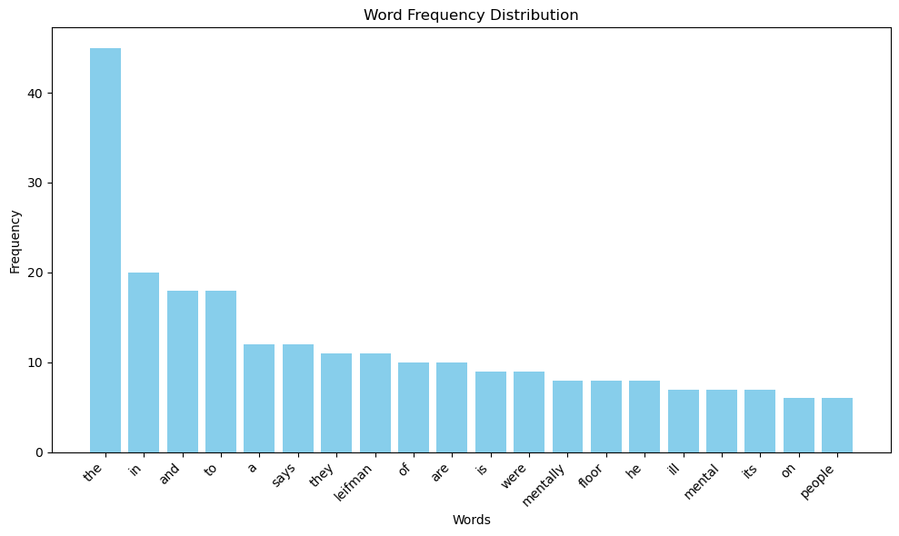
Outcomes
Most Frequent Words in the Text

Slide 6
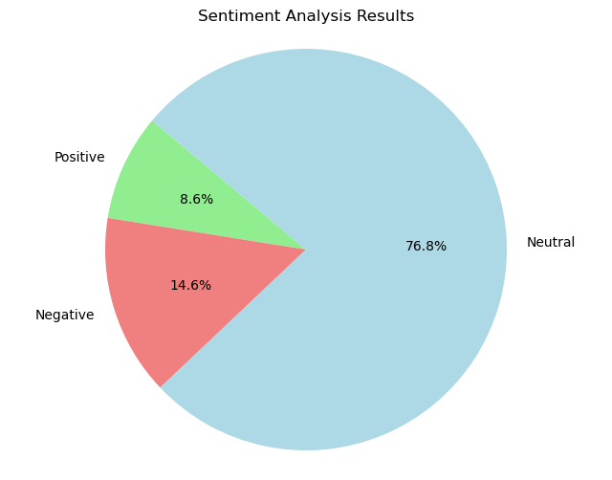
Sentiment Analysis of the Text

Slide 7
Text Summarization
The ninth floor of the miamidade pretrial detention facility is dubbed the forgotten floor . Inmates with the most severe mental illnesses are incarcerated until theyre ready to appear in court . They face drug charges or charges of assaulting an officer charges that judge steven leifman says are usually avoidable felonies . The judge says he has become a strong advocate for changing things in Miami.

Slide 8

Delays at EWR Per Year
Audio Generated by BARK
Audio Generated by GTTs

Slide 9
Text generated by Wav2Vec2
BUT OUR HUNDRED PER CENT OFF FROM MAY FOURTH FIRST WE HAVE AN ELECTRIC TOOTHBRUSH WITH EIGHT REPLACEMENTHEADS SCROLLED DOWN

Slide 10
Conclusion
Successfully built an interface with text summarization using BART which is a model in Transformers. Built TTS using GTTs pre-trained model. Built STT using Wav2Vec2 models.
This interface can be used by handicap people which will build the communication gap.

Slide 11
Reference
A.Venkataramana, K. Srividya and R. Cristin, "Abstractive Text Summarization Using BART," 2022 IEEE 2nd Mysore Sub Section International Conference (MysuruCon), Mysuru, India, 2022, pp. 1-6, doi: 10.1109/MysuruCon55714.2022.9972639. https://ieeexplore.ieee.org/document/9972639
Baevski, A., & Auli, M. (2020). wav2vec 2.0: A framework for self-supervised learning of speech representations. In International Conference on Learning Representations (ICLR).
Jean, C., & Peter, B. (2004). "Recognition of Arm Gestures Using Multiple Orientation Sensors: Gesture Classification." IEEE Intelligent Transportation Systems Conference on Electronics, 13(1), 334-520. https://www.researchgate.net/publication/336114939_366ICERT-155-pdf
KDNuggets. (2021, March). How to Convert Speech to Text with Wav2Vec. KDnuggets. Retrieved from https://www.kdnuggets.com/2021/03/speech-text-wav2vec.html

Slide 12
Reference
Khete, T., & Bakshi, A. (2022). Autonomous Assistance System for Visually Impaired using Tesseract OCR & gTTS. Journal of Physics: Conference Series, 2327(1), 012065. https://doi.org/10.1088/1742-6596/2327/1/012065
Lewis, M., Liu, Y., Goyal, N., Ghazvininejad, M., Mohamed, A., Levy, O., Stoyanov, V., & Zettlemoyer, L. (2020). BART: Denoising Sequence-to-Sequence Pre-training for Natural Language Generation, Translation, and Comprehension. arXiv preprint arXiv:1910.13461.
Vaswani, A., Shazeer, N., Parmar, N., Uszkoreit, J., Jones, L., Gomez, A. N., ... & Polosukhin, I. (2017). Attention is all you need. In Advances in neural information processing systems (pp. 5998-6008).

Slide 13

Thank you

